Slide 1
Modulating Wood-Drying Analysis System
LeeSSi
이희중, 이계혁, 이상인

Slide 2
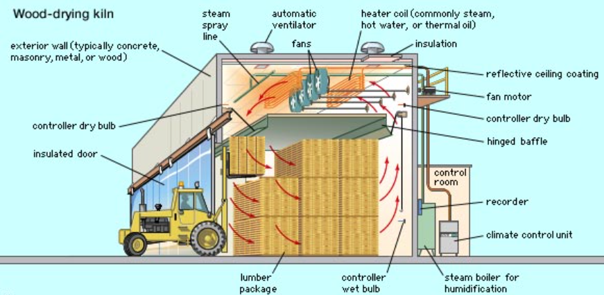
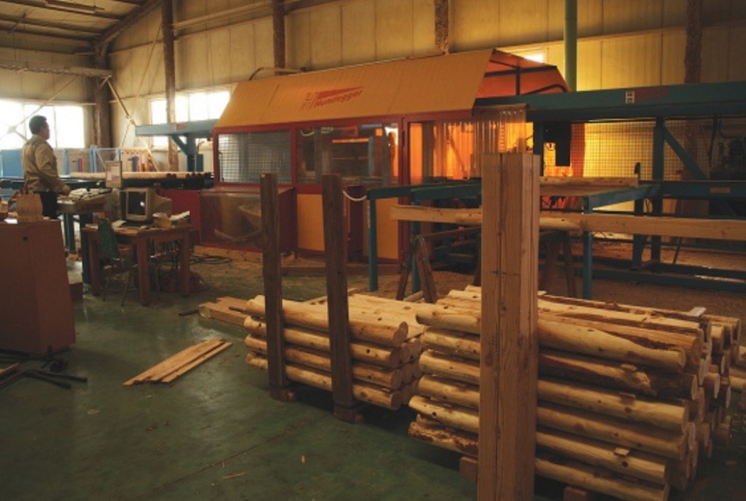
1. Project Introduction
a. Abstract
To use the wood for any purpose it should be dried
Want know the proper temperature

Slide 3
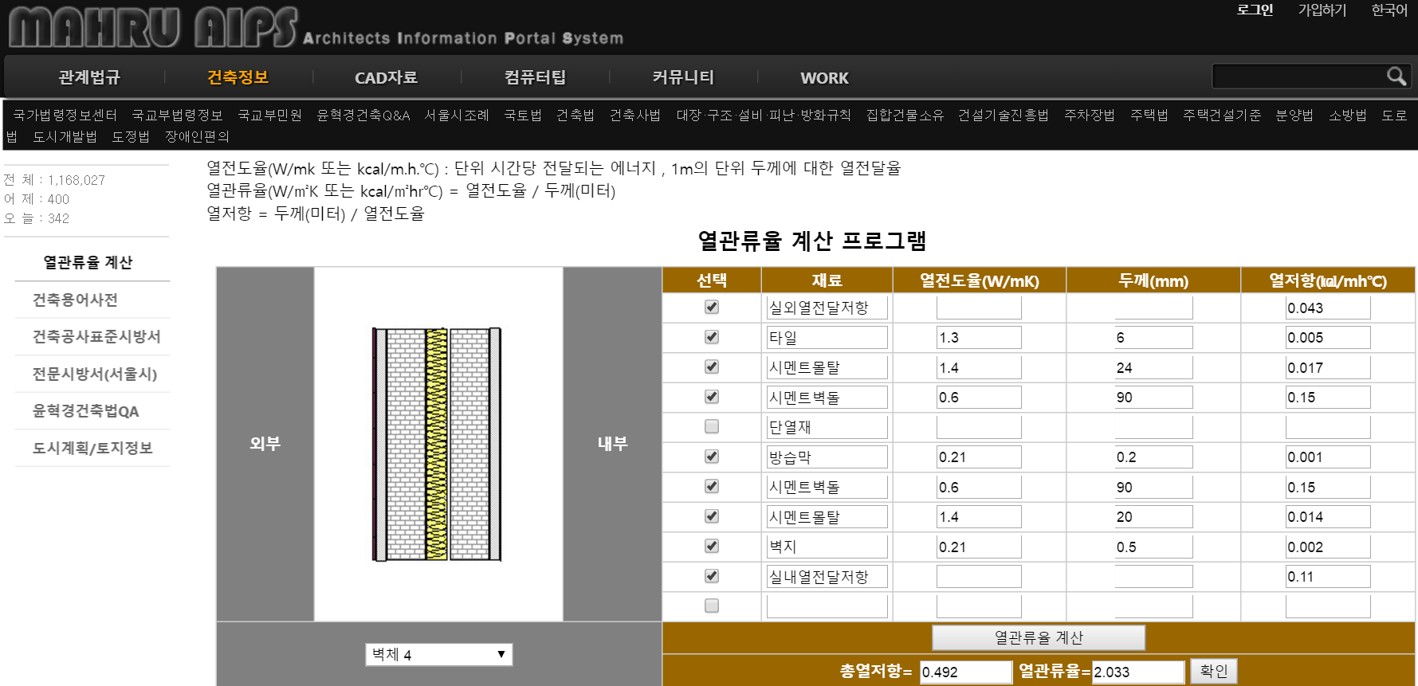
1. Project Introduction
b. Related Work
1. MAHRU AIPS
http://mahru.co.kr/KValue

Slide 4
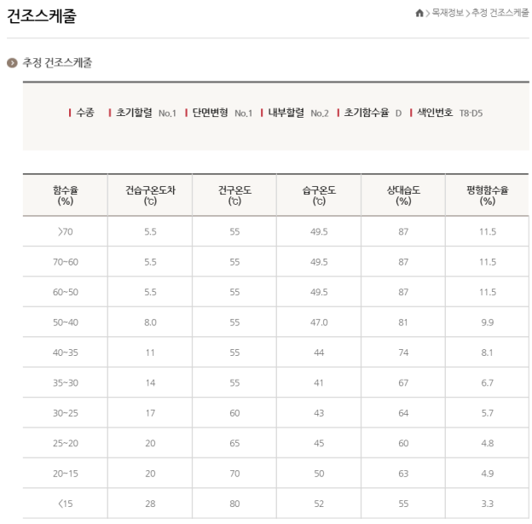
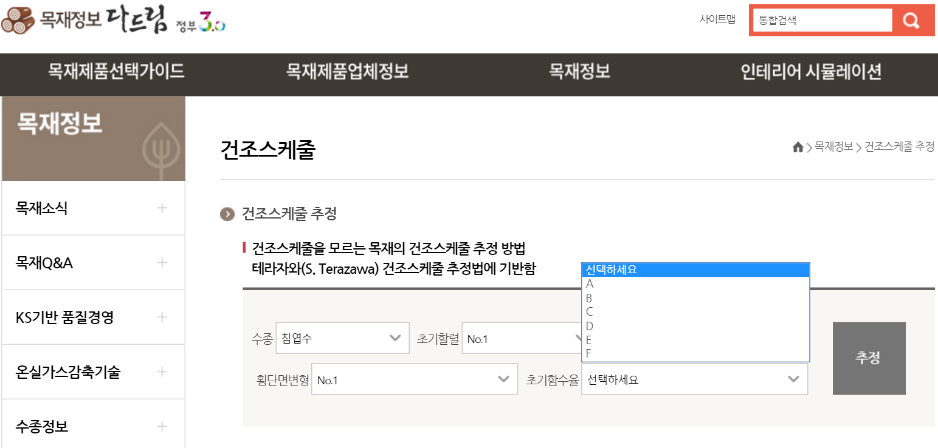
1. Project Introduction
b. Related Work
2. 목재정보 다드림
http://wood.kofpi.or.kr/woodInfo/drySchdMade.do
Notes:
If the user select the species and thickness of the wood and the system calculates drying schedule and show like this table

Slide 5
1. Project Introduction
c. Objective
The setting dry & wet temperature was arranged
Before Determined by the worker’s experience
Future Calculate the history data and get the settings with Leessi’s system
Get the Data Quickly & Accurately
Notes:
Again, we want to calculate the total duration and their settings based on historical data. If the user set the dry and wet temperature, Our algorithm will allow the user to get the data quickly and accurately.

Slide 6
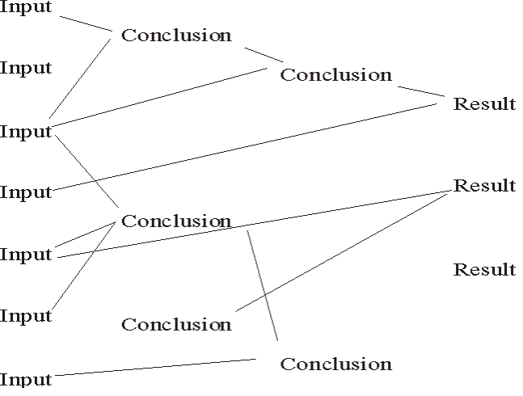
2. Methodology
a. Main Algorithm
1. Principle of the Algorithm
Forward chaining
Input
Output
AW Temp
SW Temp
AD Temp
SD Temp
MC
Duration
Threshold

Slide 7
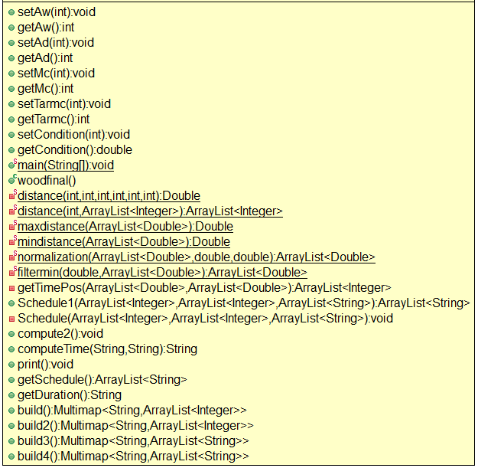
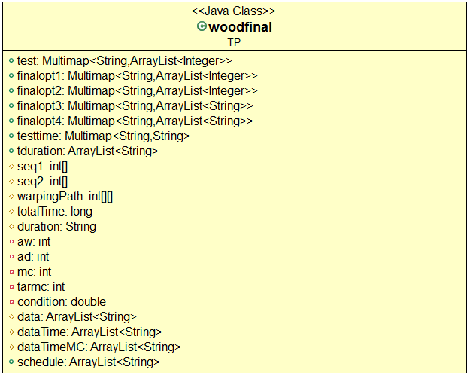
2. Methodology
a. Main Algorithm
2. Class Diagram
Notes:
This is our class diagram.

Slide 8
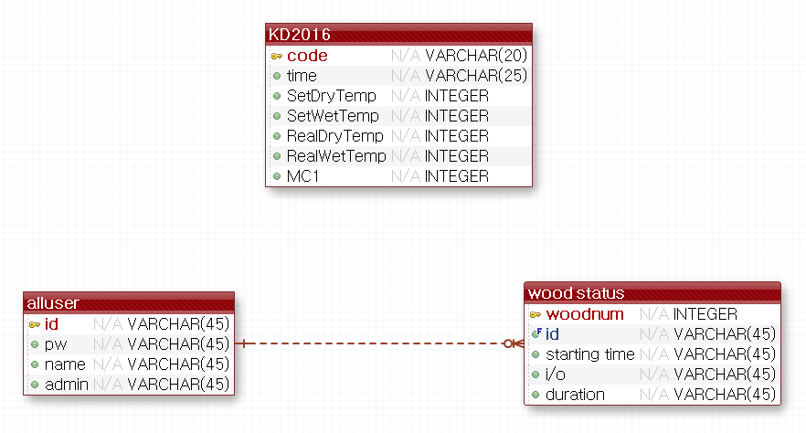
2. Methodology
b. System Architecture
1. Data representation ERD
Notes:
This is database that we are going to use. KD2016 is the historical data and remainder ones is used for user management and process control.

Slide 9
2. Methodology
home
b. System Architecture
login
2. Use Case Diagram
check
error
Admin
pagemain
Admin_userlist
Admin_edit
user
User
pagemain
admin
User
ownedit
User_own_update
User_
checkwork
input
output1
output2
logout

Slide 10
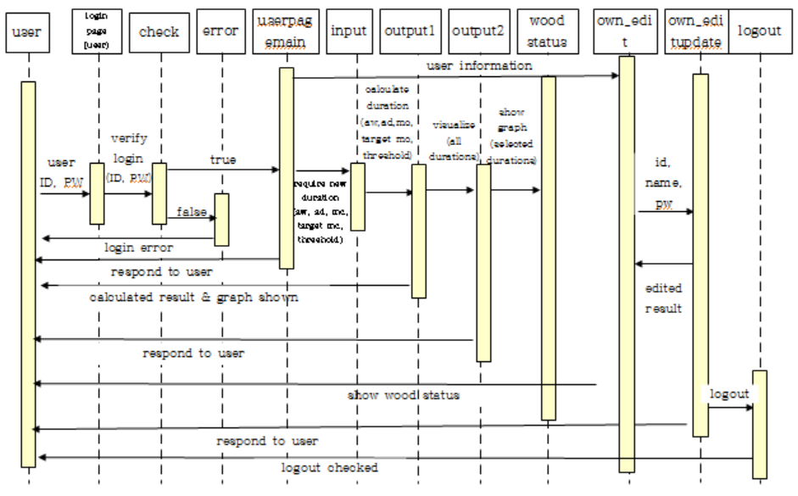
2. Methodology
b. System Architecture
3. Sequence Diagram (User)

Slide 11
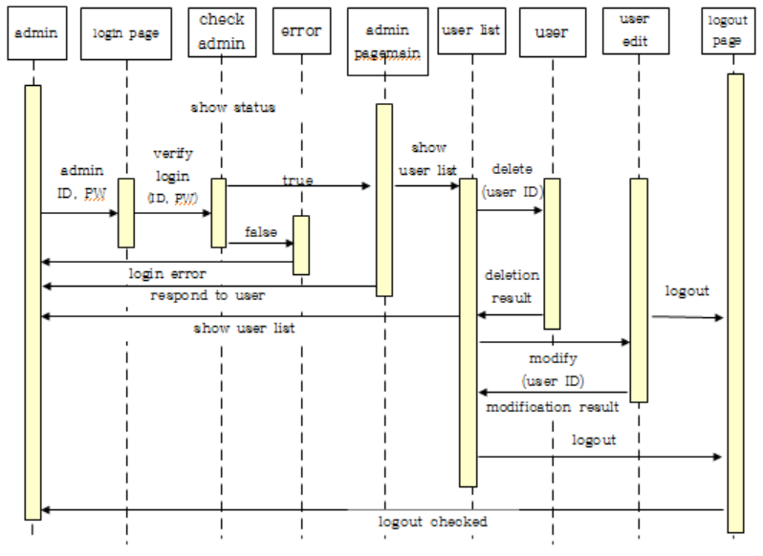
2. Methodology
b. System Architecture
3. Sequence Diagram (Admin)

Slide 12
2. Methodology
b. System Architecture
4. System Architecture
Process
Resource Utilizers
User
Input
Calculate Access Use Search Request Gather Submit Alert
Analysis
AW Temp
AD Temp
MC
Target MC
Threshold
Admin
Table
Calculate Access Use Search Request Gather Submit
Alert Edit
Graph
Store Manage Expose Update
Metadata
Asset
Repositories

Slide 13
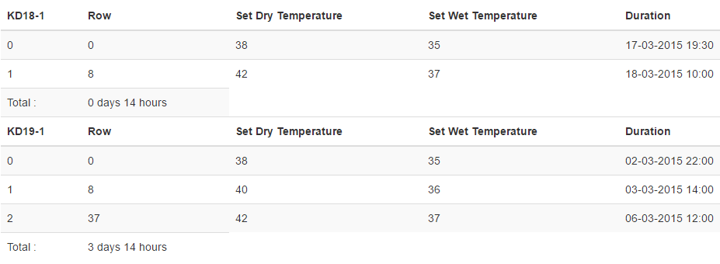
3. Expected Result
[1] Setting Dry & Wet Temp and Duration

Slide 14
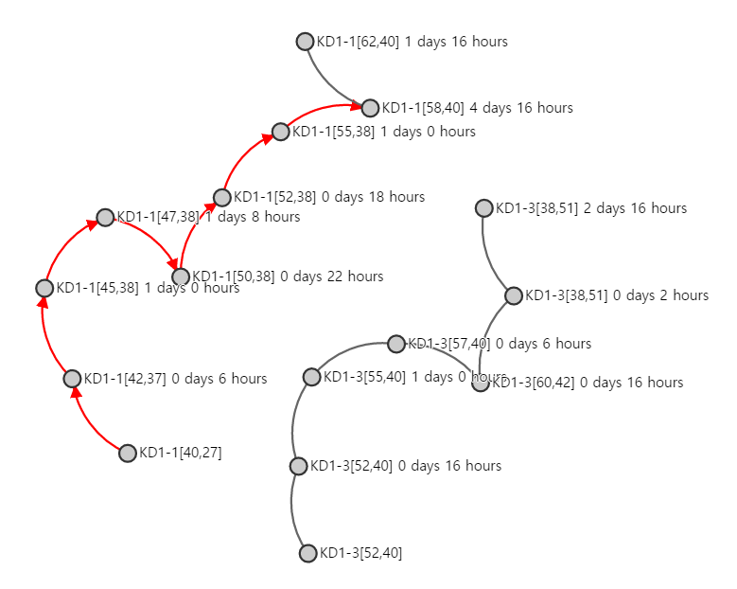
3. Expected Result
[2] Mobile Patent Suits
출처: http://bl.ocks.org/mbostock/1153292

Slide 15
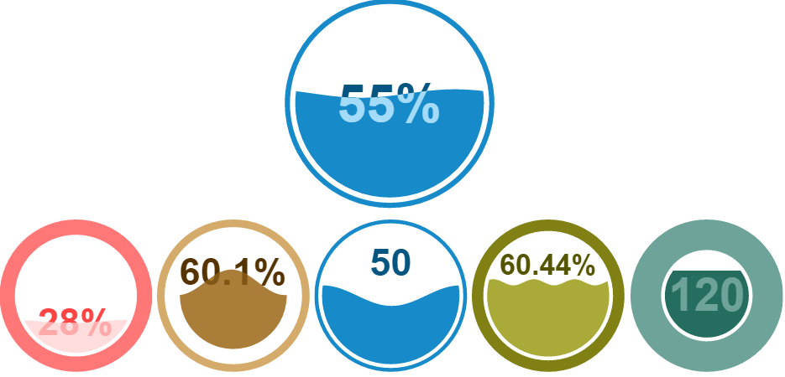
3. Expected Result
[3] D3 Liquid Fill Gauge
http://bl.ocks.org/brattonc/5e5ce9beee483220e2f6

Slide 16
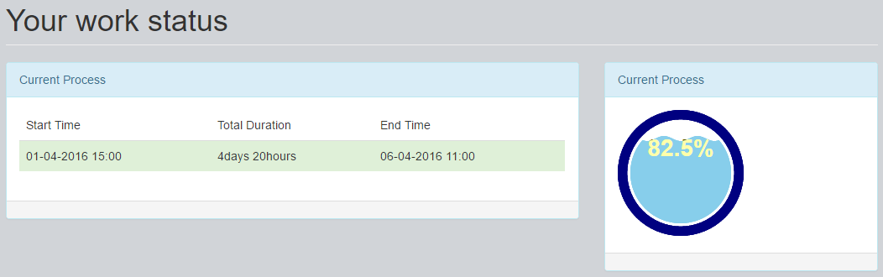
3. Expected Result
[3] D3 Liquid Fill Gauge
http://bl.ocks.org/brattonc/5e5ce9beee483220e2f6

Slide 17
4. Role for each member
이희중
이계혁
이상인
Construct Algorithm
Code Assistance
Report
Graph search
JSP css search
Error search
Construct Algorithm
Code Master
Data Visualization
Construct Algorithm
Code Assistance
Managing DB
JSP expose
Data Visualization

Slide 18
5. Demo
http://localhost:8080/StudyJSP/home.jsp
Notes:
Forward chaining starts with the available data and uses inference rules to extract more data (from an end user, for example) until a goal is reached. An inference engine using forward chaining searches the inference rules until it finds one where the antecedent (If clause) is known to be true. When such a rule is found, the engine can conclude, or infer, the consequent (Then clause), resulting in the addition of new information to its data.[

Slide 19
THANK YOU
Notes:
Forward chaining starts with the available data and uses inference rules to extract more data (from an end user, for example) until a goal is reached. An inference engine using forward chaining searches the inference rules until it finds one where the antecedent (If clause) is known to be true. When such a rule is found, the engine can conclude, or infer, the consequent (Then clause), resulting in the addition of new information to its data.[

